Slide 1
Notes
on the installation
of a
GNSS station
and
Weather Station

Slide 2
GNSS (Global Navivation Satellite Systems) is the answer to the question: Where am I?
The problem of knowing where you are has, over time, been solved in various ways (points of reference on the ground; the sun; the stars, etc.), but never in a global way and often with unsatisfactory accuracy.
After World War II, several methods were developed for automatic position calculation, either by measuring distance to various "landmarks" or by using radio waves.

Slide 3
These systems, however, had limitations (low coverage, no information at altitude, low accuracy).
At the beginning of the 70s, for essentially military reasons, the global positioning project GPS started, based on the reception of radio signals emitted by a series of artificial satellites in orbit around the earth and designed in such a way as to allow at any time and in every place on the earth's surface the 3D positioning of an object even in motion.

Slide 4
Why GNSS?
Independent of weather conditions
Intervisibility is not required
High precision
It works day and night
Universal coordinate system
Suitable for many applications (monitoring, navigation, meteorological applications…
Low cost system
Notes:
5

Slide 5
Global Navivation Satellite Systems - GNSS
There are several satellite navigation systems nowadays
GPS - USA System
GLONASS – System of the Russian Confederation
GALILEO - European Community system
BEIDOU – System of the People's Republic of China
QZSS - Japanese System
Notes:
5

Slide 6
What to consider
when
installing a GPS station
Notes:
2

Slide 7
Il Multipath
Multipath is the phenomenon for which the signal transmitted by the satellite is reflected by surfaces located close to the antenna
Multipath
i
r
Notes:
1

Slide 8
Il Multipath , le Interferenze,...
Due to Multipath and electromagnetic interference the quality of the GPS signal may get worse...
Multipath
i
r
electromagnetic interference:
Radio, Power lines, etc.
Notes:
1

Slide 9
Multipath
It decreases the signal-to-noise ratio
It is greater at low elevation ➔ record with satellites with elevation above 15 °
The effect is repeated, with the same characteristics, with the repetition of the geometric configuration of the satellites ➔ use multy-day recordings
Use antennas (Choke Ring) which don’t acquire reflected signals
Interferenze radio
Radio interference causes a reduction in the signal-to-noise ratio, with a consequent increase in the measurement error

Slide 10
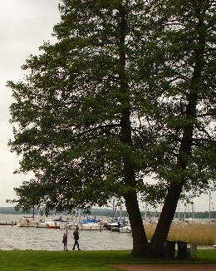
….and the obstructions
Due to obstacles, the signal may not reach the GPS antenna ...
Notes:
1

Slide 11
What to avoid...
- Electromagnetic interferences
- Multipath
- Satellites below 15°
- Obstacle above i 15°
Free
signal
Noisy
Signal
Covered signal
electromagnetic interference:
Radio, Power lines, etc.
Notes:
1

Slide 12
….The solutions
Multipath and Interferences:
The GPS receivers perform automatic procedures:
better signal recording
noise mitigation (filter)
Obstructions
To solve the problem you can:
If it is really necessary to install a GNSS antenna in the presence of obstacles, position the receiver so as to have the obstacle to the North
Notes:
1

Slide 13
Summing up
Carry out the measurement with:
- At least the same 4 - 5 Satellites
- A good Signal-to-Noise ratio
- Elevation of the satellite above 15°
Avoid the following conditions:
- Obstacles above 15°
- Electromagnetic interferences
- Multipath
Notes:
34

Slide 14
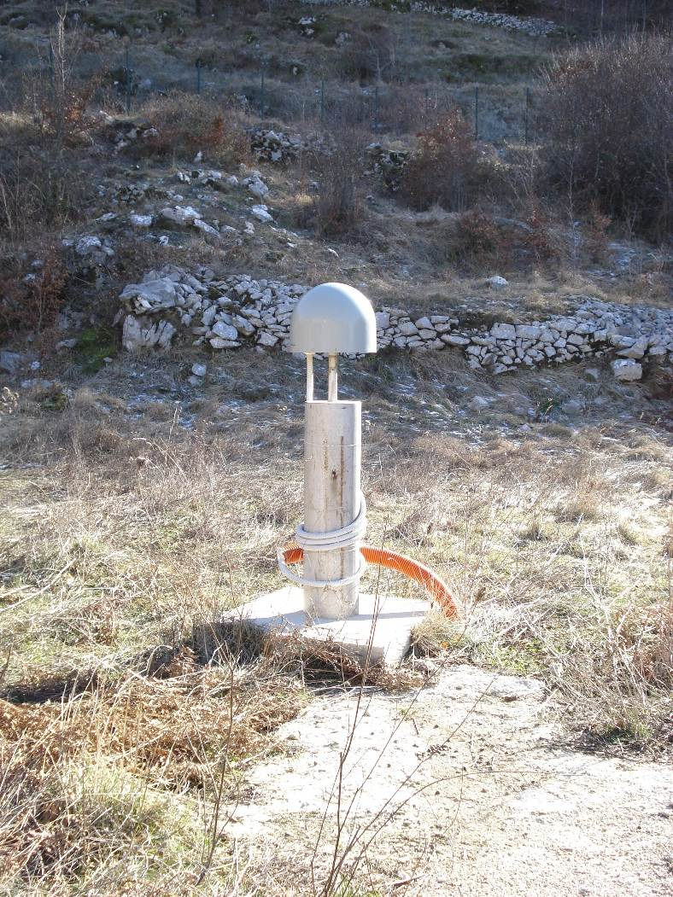
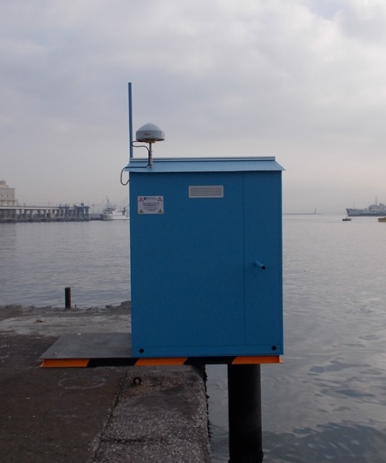
Example of installation
GNSS Station of the
INGV Network called RING
GNSS and Tide Gauge Stations
of the INGV Network
Installed in the Neapolitan Volcanic Area
Notes:
34

Slide 15
How to Install
A
Weather Station

Slide 16
The Standards
The rules for the positioning of weather stations have been established by the World Meteorological Organization, WMO.
World
Meteorological
Organization
WMO

Slide 17
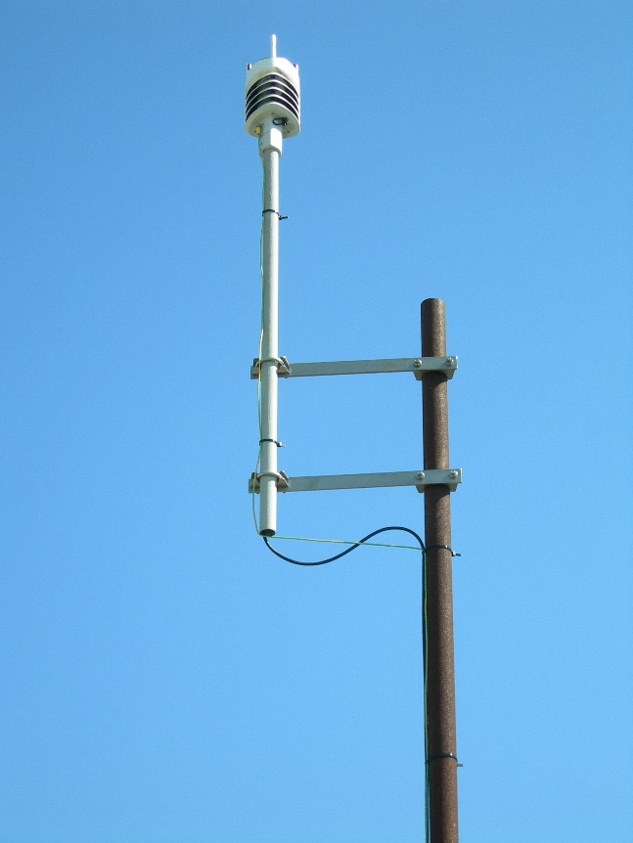
Installation in urban areas – 1/3
Let's imagine we want to install a weather station consisting of the following sensors:
Thermometer
Hygrometer
Rain gauge
Barometer
Weather Station of INGV Network
Installed in Neapolitan Volcanic Area

Slide 18
Installation in urban areas – 2/3
The thermometer is the instrument that measures the temperature
The hygrometer, on the other hand, measures humidity
The barometer measures the atmospheric pressure
They must be installed at a height from the ground between about 1.7 and 9.5 meters and at least 4 meters away from obstacles.
In particular, if installed on the roof of a building, they must be installed at least 2 meters high, in order to limit the effect of the heat released by the buildings.
In addition, they must be housed in special containers that prevent instruments from being hit by direct sunlight. Direct sunlight could cause the measurement of non-real values of temperature and humidity.

Slide 19
Installation in urban areas – 3/3
The rain gauge is the instrument that measures the amount of precipitated water.
It must be installed at the same height as the thermometer and hygrometer.
Buildings closest to the weather station must be at least 10 meters away so that the rain gauge does not receive less rain than it actually does.

Slide 20
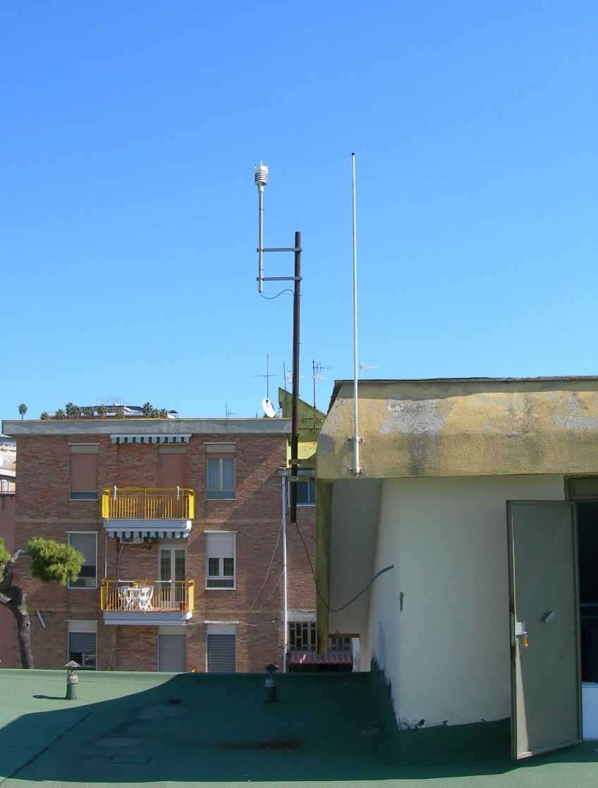
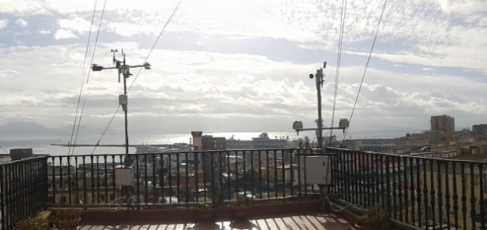
Installation examples
MAFE Weather Station
DiSTAR-UNINA
Weather Station belonging to Istituto Nazionale di Geofisica e Vulcanologia (INGV) Network
Installed in the Neapolitan volcanic area
Notes:
34

Slide 21
Thanks for the Attention
CC BY 4.0

